Slide 1

IoT Simulators NS3 and SUMO
Presented By – Shreya Mishra
Indian Institute Of Science

Slide 2
Why do we need Simulators ?
Network connection plays a vital role as IoT is all about the data being communicated in faster speeds all the time. IoT architecture has to be tested in all kinds of network connectivity/speeds. To test this, virtual network simulators are mostly used to vary the network load, connectivity, stability etc.
Availability
Portability
Cost effective
No Time Constraints
Ease of setup
Examples – Cooja , NS3, SUMO, Gazebo

Slide 3
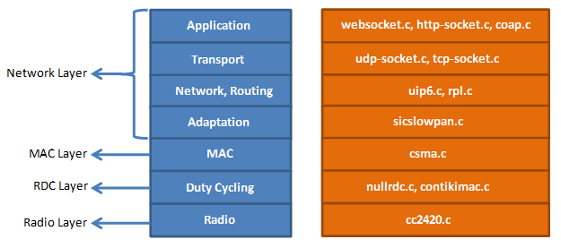
When to choose what? (Cooja/NS3/MiniNet)
Contiki plays the best role when working with power constrained networks.
Eg- 802.15.4
Best to be used with Zolertia motes, TelosB
RPL knowledge is necessary
Knowledge Of C is must
NS3 is suitable to test almost all real time network usage eg- Wi-Fi, LTE, FANET etc
Can be used for Drone/V2x simulation
Network /Link Performance Analysis is easy
Knowledge Of C++ and Python is must
MiniNet acts as an emulator for SDN networks
Supports
The Mininet-WiFi developers extended the functionality of Mininet by adding virtualized WiFi stations and access points based on the standard Linux wireless drivers and the 80211_hwsim wireless simulation driver.

Slide 4
Network Simulator (NS3)
Ns3 is a discrete event network simulator. It provides a simulation time and it jump from one event to another event. Ns3 contains various inbuilt libraries and modules within a directory. It supports Graphical user interface and python bindings.
Model Development
Develop by a Defined Channel and Mobility Models
Simulate a Model according to Events
Node and also Link Configuration
Define Node and Link Attributes (Data rate, Latency and also Packet Loss)
Manage Command Arguments
Simulation Execution
Building a File and also Analyze Outputs in a Command Prompt
Performance Analysis
Modeling Network by using NetAnim
Analyze the Performance under GNU plot
ns-3 | a discrete-event network simulator for internet systems (nsnam.org)

Slide 5
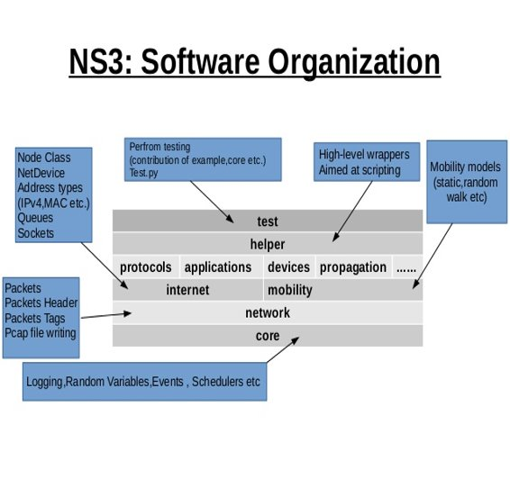
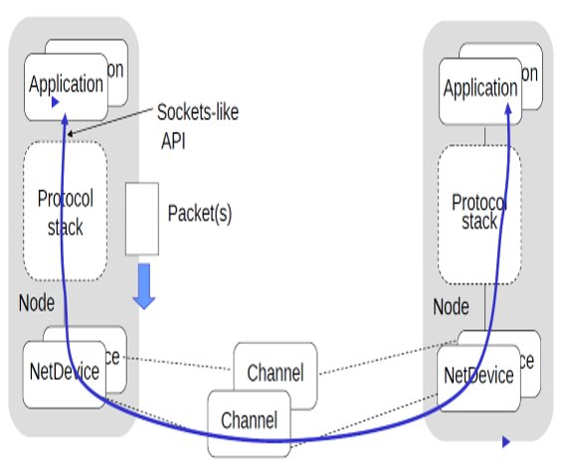
How Does NS3 Work?

Slide 6
SUMO (Simulation Of Urban Mobility)
• SUMO is an open source traffic simulation package including net import and demand modeling components.
• The German Aerospace Center (DLR) started the development of SUMO back in 2001.
• It involves route choice and traffic light algorithm or simulating vehicular communication.
Features
Automated Driving, Vehicle Communication, Traffic Management, Microscopic Simulation, Multimodal Traffic, Online Interaction, Network Import
Definition of Vehicles, Vehicle Types, and Routes - SUMO Documentation (dlr.de)

Slide 7
Working (Sumo)
In order to create simulation in SUMO first create a road network on which vehicles can move.
The road network consists of nodes (junctions) and edges (i.e. roads that connect various junctions with each other).
Road network can be created in three ways:
1. Manually by creating your own node file, edge file and connection file.
2. Using NETGENERATE command.
3. Importing road network from non SUMO formats like OSM, VISSIM, VISUM etc

